Slide 1

Unreal engine advnced
Git Submission work flow

Slide 2

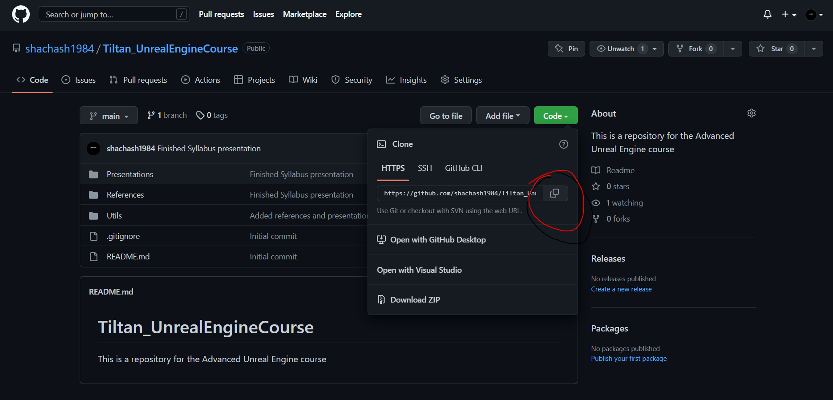
Cloning the Course repo
This Photo by Unknown Author is licensed under CC BY
This Photo by Unknown Author is licensed under CC BY-NC

Slide 3
Cloning the Course repo
This Photo by Unknown Author is licensed under CC BY

Slide 4

Moving to another branch
This Photo by Unknown Author is licensed under CC BY

Slide 5

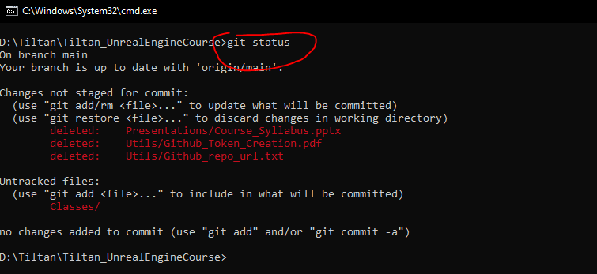
Checking current status
Red lines are “Unstaged” Changes, AKA: “Working tree changes”
This Photo by Unknown Author is licensed under CC BY

Slide 6
Staging Changes
Red lines are “Unstaged” Changes
This Photo by Unknown Author is licensed under CC BY

Slide 7
Thank you!
Best of luck!

